Slide 1
Mathematischer Beweis
2 = 1

Slide 2
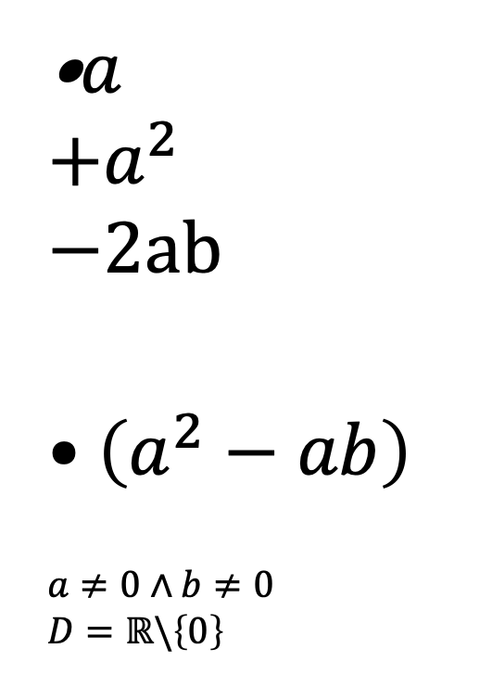
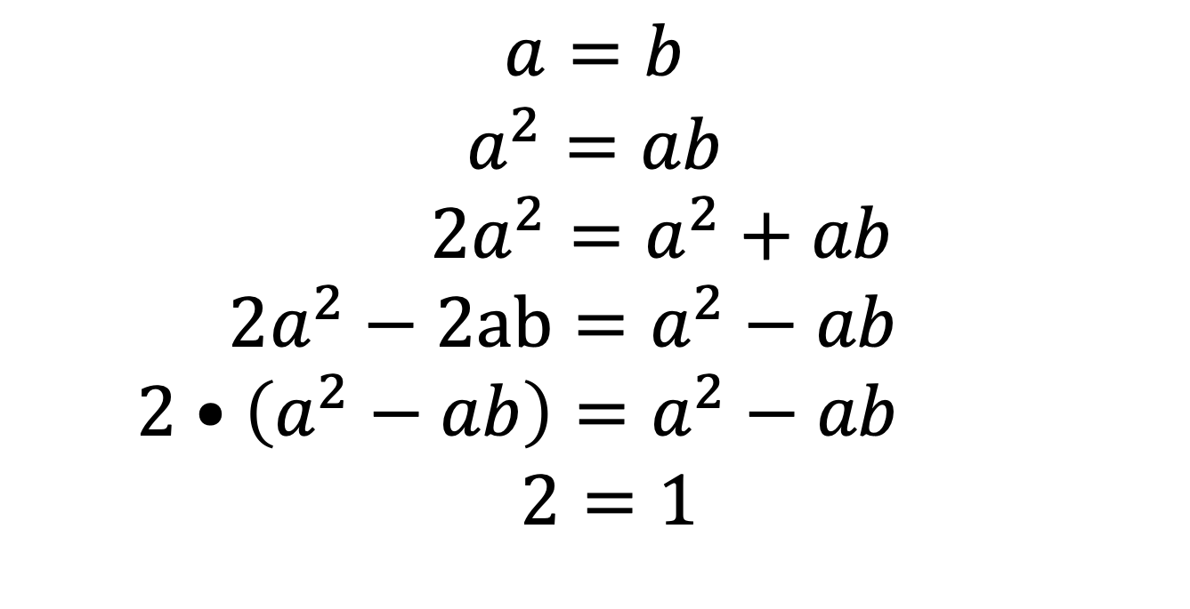
Behauptung: 2 = 1
$$a=b$$
$$a^{2}=ab$$
$$2a^{2}=a^{2}+ab$$
$$2a^{2}−2ab=a^{2}−ab$$
$$2•\left(a^{2}−ab\right)=a^{2}−ab$$
$$2=1$$
•$a$
$$+a^{2}$$
$$−2ab$$
$$•\left(a^{2}−ab\right)$$
$$a≠0∧b≠0$$
$$D=ℝ\backslash \left\{0\right\}$$

